Slide 1



Professional Development Week | President’s Address
PROFESSIONAL DEVELOPMENT WEEK
PRESIDENT’S ADDRESS SPRING 2025

Slide 2

Federal Budget Issues

Slide 3

Federal Immigration Issues

Slide 4

Questions?

Slide 5
Enrollment | AFTE
Unduplicated Headcount
AY22/23 = 17,377 students
AY 23/24 = 17,742 students
Difference: 365 students
Fall 2024 Percentages:
Headcount +1.3% | FTE +3.4%
Projected Spring 2025 Percentages:
FTE: +5-6%
(Compared to previous year)

Slide 6
Retention

Slide 7
Retention By Ethnicity

Slide 8
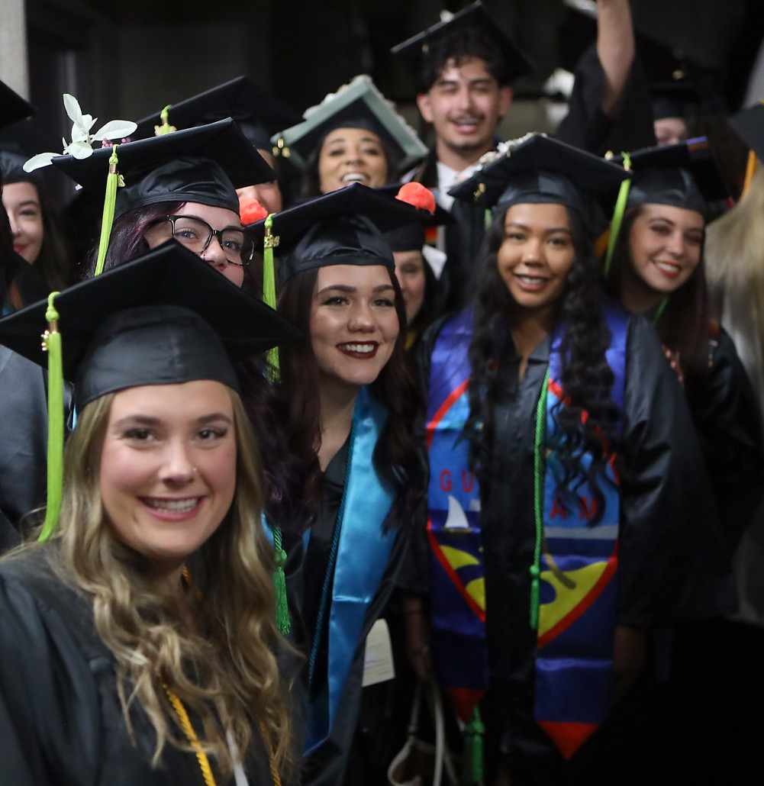
Graduation
Degrees & Certificates
3,970 | 17/18
4,060 | 18/19
3,879 | 19/20
3,562 | 20/21
3,051 | 21/22
3,242 | 22/23
3,256 | 23/24*
*Includes 71 BSN/BAS degrees

Slide 9
Achieving HSI Designation

Slide 10
Reserve Balance History

Slide 11
Key Budgeting Dates
Staffing Requests:
  2/3 – 2/24
Budget Requests (25/26):
  2/24 – 3/14
Remodel/Renovation Requests:
  2/24 – 3/14

Slide 12
Instructional Services

Slide 13









HLC 2025 Comprehensive Evaluation Visit Timeline
Started Spring 2024
October 2024: Fall Accreditation Town Hall
January 2025: Spring PDW Accreditation Workshops
February 17 & 18: Mock Visit
March 2025: Spring Accreditation Town Hall
April 14 & 15, 2025: On-Campus Visit
May 2025: Results
Notes:
Patricia

Slide 14
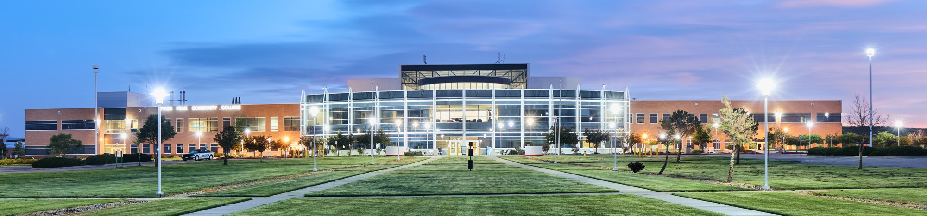
Criteria for Accreditation
Criteria for Accreditation
The Five criteria for accreditation:
Criteria for Accreditation are “the standards of quality by which HLC determines whether an institution merits accreditation or reaffirmation of accreditation.” (HLC, 2020)
Criterion 1 – Mission
Criterion 2 – Integrity: Ethical and Responsible Conduct
Criterion 3 – Teaching and Learning:
Quality Resources, and Support
Criterion 4 – Teaching and Learning:
Evaluation and Improvement
Criterion 5 – Institutional Effectiveness,
Resources and Planning
Notes:
Emphasize what does this mean for you?
It means that faculty and staff may be contacted by the writers to provide details and evidentiary documents. For instance, faculty may be asked to share their program review reports and evidence showing how they have used program review findings to improve their program. Library staff may be contacted to explain how they support students. Student life staff may be contacted to provide details on campus events,….

Slide 15
Why is regional accreditation important?
  Access to Federal Funding: makes education more accessible to students.
  Recognized Degrees: enhanced student’s employability.
  Transferability of Credits: credits earned at accredited institutions are more likely to be accepted by other institutions.
  Community Recognition: enhanced reputation and support from local partners.
  Quality Assurance: evidence that institution meets rigorous educational standards.
  Continuous improvement: accreditation process encourages institutions to engage in self-assessment and continuous improvement efforts.
Notes:
Deb

Slide 16

Mock Visit, February 17 & 18
Objective: prepare PPSC for the actual visit
Three experienced HLC reviewers:
  Janna Oakes (CO), Jennifer Miller (Iowa), and
  Tristan Londre (Missouri)
Within 10 days of the mock visit, PPSC will receive
  feedback regarding the draft Assurance Argument
  and quality of evidence
  an assessment of the preparedness of the
  PPSC community
  recommendations for improvement (if any)

Slide 17
Actual On-site Visit, April 14 &15
Purpose: On-site peer review visit to confirm the accuracy of the PPSC's narrative, gather additional evidence, and make accreditation reaffirmation recommendations to the Institutional Actions Council (IAC).
Review Team
Name | Title | Institution
Randall Fletcher | VP of Academic & Student Affairs | Eastern Florida State College, FL
Kaylyn Bondy | VP for Student Affairs, Title IX Coordinator | Bismarck State College, ND
Gene Kramer | Professor | University of Cincinnati Blue Ash College, OH
Ronna Vanderslice | VP for Academic Affairs | Oklahoma State University Institute of Technology-Okmulgee, OK
Courtney Bruch | Director of Assessment and Accreditation | Northern New Mexico College, NM
Areas of emphasis:
  Accuracy of information (e.g., website, catalog, syllabus)
  Alignment between operations and mission/strategic priorities
  Program review and assessment (commitment to continuous improvement)
  Faculty/instructors credentialing (review of randomly selected HR files during the visit)
  Online education (especially Regular and Substantive Interaction)
  Ethical and responsible conduct (e.g., use of AI and recruitment/admission practices)

Slide 18
How you can contribute
Engage in Workshops: Participate in lunch discussions.
Practice & Prepare: Join mock visits (Feb 17–18) and Open Forums (March) to refine responses and elevator speeches.
Participate in On-Site Visit: Be involved during the April 14–15 visit.
Stay Updated: Watch Dr. Bolton’s updates, read press releases, and attend town halls.
Document Efforts: Keep minutes, track professional development, follow policies, and use evaluation data for improvement.
If you have questions, please contact:
Patricia Grandieu: Patricia.Grandieu@PikesPeak.edu
Deb Licht: Deborah.Licht@PikesPeak.edu
Notes:
Deb

Slide 19
Colorado Online Update
3,037 Total CCCS Sections
685
Total
47 New Faculty and Instructors: Enrolled in the Essentials of Teaching and Learning Bootcamp.
Testing New Automated LMS Introduction for students

Slide 20
High School Programs & Workforce Development
HSP and WF will be split into two different operations in order to focus more intentionally on both areas.
Director of Concurrent Enrollment position has been posted. This position will be dedicated to sustaining and strengthening our K-12 partnerships. Janet Avion is the main point of contact for High School Programs until this position is filled.
We expect to post a Director of Workforce position later this spring. In the meantime, Gary Walker will be the main contact for Workforce.

Slide 21

New & Upcoming Programs
Certificates
Practical Nursing Certificate – Fall 2025
Precision Machining Certificate – Fall 2025
Associate Degree Programs
AAS Music Audio Technology – Fall 2025
Paramedic to RN – Fall 2025
LPN to RN – Fall 2025
AAS Dental Hygiene – Summer 2025
Bachelor Degree Programs
BAS Business – Spring 2025
BAS Elementary Education Digital Literacy – Fall 2025
BAS Behavioral Health – Fall 2025

Slide 22

AI
Respondus Lockdown Browser
Instructional Services Departmental
AI Integrations Policy Development
Empowering instructors to handle unethical use of AI in the classroom
Effective integration in curriculum
System-level policy group: syllabi recommendations, and a vision forward.
PPSC represented by Dennis Natali.
AI Summit Announcement: CETL partnering with the Instructional Technology Council to offer an AI Summit on February 14th.
Notes:
PPSC will invest in a limited number of professional licenses for faculty

Slide 23



Promise Programs
Ballot Issue 4A
Notes:
How many students, graduates, enrolled, transfers, how much money we gave out

Slide 24
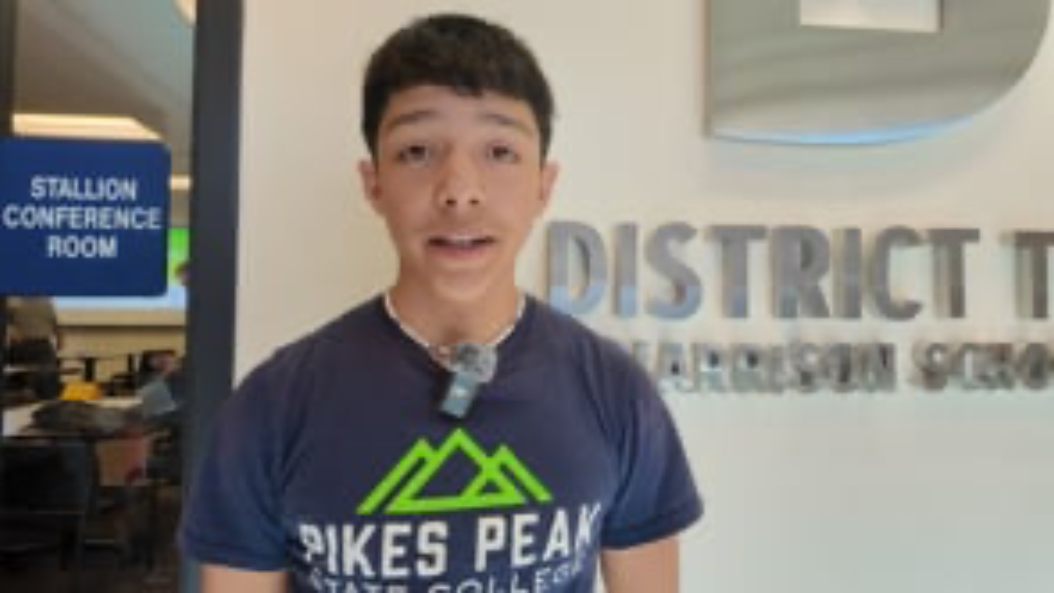
D2 Promise Video
Video Credit: Harrison School D2
Notes:
Embed video

Slide 25
Student Experience & Equity

Slide 26


Single Stop
Supporting Participants:
753 participants assisted in
the 23/24 Academic Year
2,924 referrals made to
on-campus and community resources
Tackling Food Insecurity:
33,025 Students, Faculty &
Staff accessed Community Table/Cupboards across
PPSC campuses
2,924 visits to the Mobile Food Market
Maximizing Financial Assistance:
Over $9.2 million in benefit
assistance identified as of
June 30, 2024

Slide 27

Canvas Community Food Pantry
Notes:
Ask Kandy if these numbers are trending up or down %

Slide 28
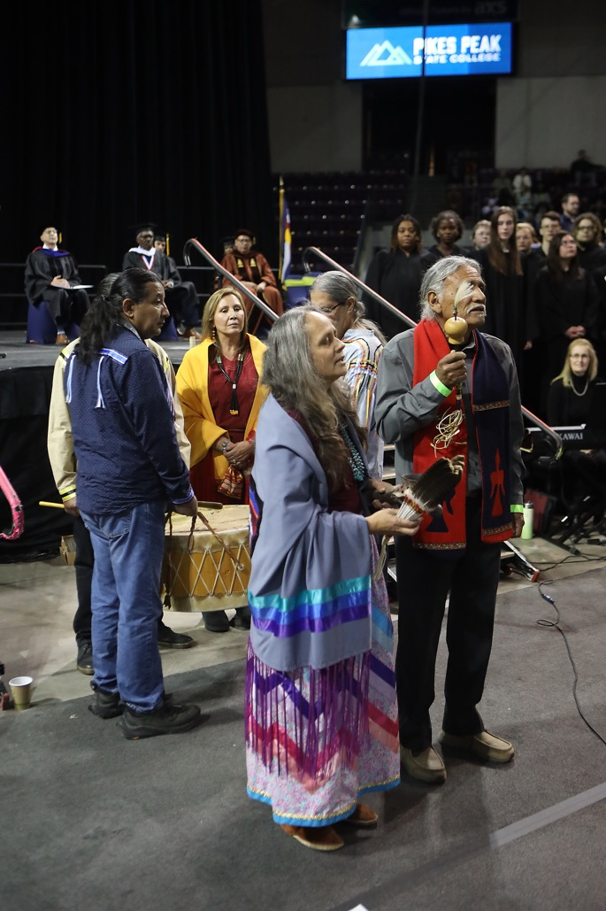
Commencement Success (2024)
Record-breaking ceremony with 633 graduates,
6,000 attendees.

Slide 29
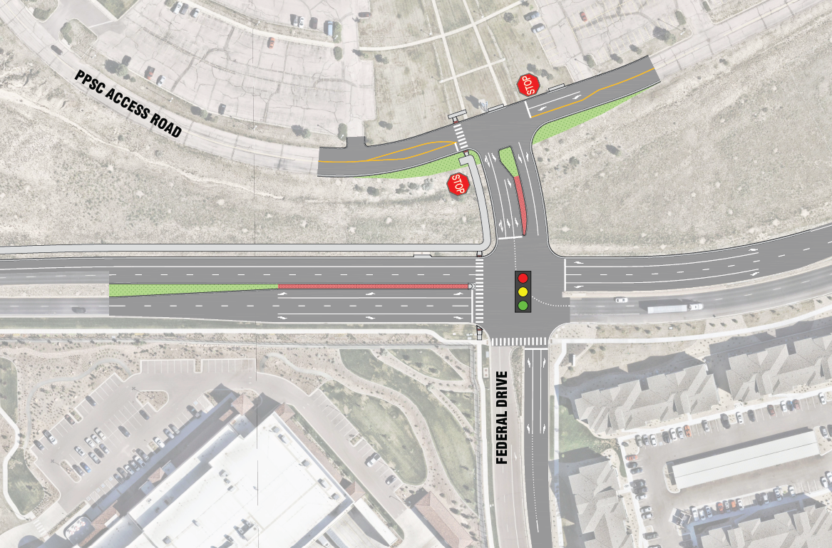
Traffic Redesign at Rampart
City of Colorado Springs has conducted a traffic study
6/8 intersections rated unacceptable
Plan to move forward on addressing traffic issues

Slide 30



Current Focus Goals & Strategic Plan Updates
Town Hall on Feb. 19 | 10–11am
Past Focus Goals:
Adult Learner Task Force
Strategic Scheduling
Employee Engagement/Campus Culture
Tuition Assistance Plan
Current Focus Goals (24–26):
HSI
Downtown Revitalization Project

Slide 31

Nearly $4 Million in Grants received in 2024
United Way (tax help): $4,054.75
Open Educational Resources: $21,375
Congressionally Directed Spending-DHHS HRSA (Dental Center): $1,000,000
AELA (D11 Career Pathways): $75,889
COSI Community Partner Program: $387,898.66
COSI Career Launch: $30,000
IN! Pathways to Inclusive Higher
Education: $303,000
NSF CRISPR (gene editing research): $165,383
Department of Defense (cybersecurity): $70,000
PIBV (Campus Police): $71,822
CDE (Learning Commons): $5,962
Law Enforcement Workforce: $67,000
Dakota Foundation (First Nations): $250,000
Daniels Fund (First Nations): $250,000
Colorado Springs Health Foundation (Community Table): $75,000
NEFE Financial Literacy: $40,000
El Pomar (Behavioral Health): $50,000
CCA AI Readiness Consortium: $10,000
Canvas Foundation (MVP Lending Library): $5,000
Delta Dental of Colorado Foundation (public health curriculum): $60,000
Opportunity Now (semiconductor): $1,056,792

Slide 32
Facilities & Operations

Slide 33
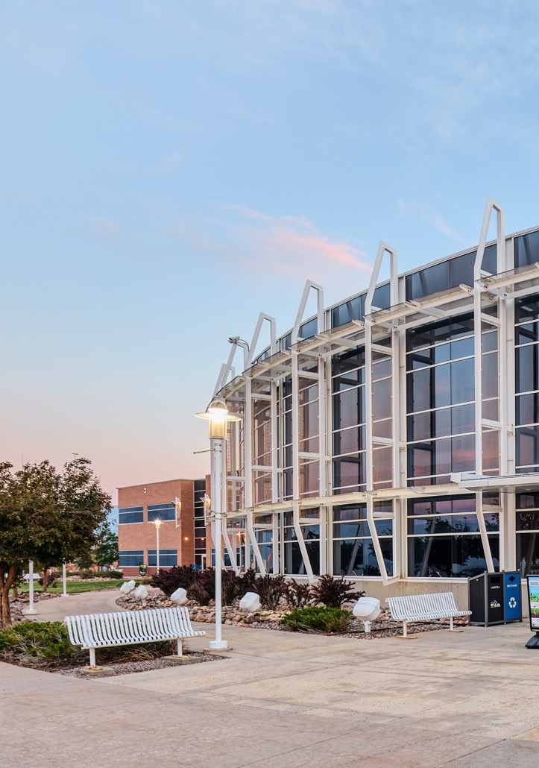
Campus Remodel/Refurbish
Furniture: Committee met in December and meets again February 13. Intent is to have RFP complete by April and all furniture in place by August.
  A110
  Classroom Furniture
  ASL/IPP Furniture
  Downtown & Rampart Student Service Offices
  Downtown Community Table
  Downtown & Rampart Counseling Centers
  Downtown & Rampart Student Common Areas
  Rampart Student Experience Areas

Slide 34
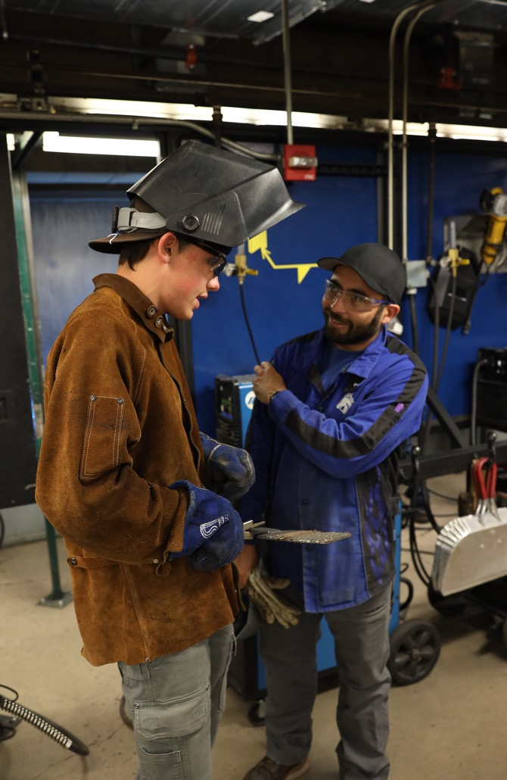
Campus Remodel/Refurbish
Remodel/Refurbish:
  Culinary Offices Carpet - Summer 2025
  CAD/EGT Expansion – Summer 2025
  Welding Lighting Upgrade – Planned Maintenance
  B253 Floor Repair – Summer 2025
  B253 Paint – Summer 2026
  Downtown Retaining Wall – Summer 2025
  Downtown: S201, S203, S204 Refresh – Summer 2025
  Rampart Learning Commons Carpet – Summer 2025

Slide 35

Campus Remodel/Refurbish
Capital Projects: The goal is to have architects assigned to all capital projects by March
  F Building & HRS Remodel
  Leadership Suite
  The Grove and Centennial Student Experience Offices
  Conference Rooms on Centennial, Rampart, and Downtown
  Music Performance and Rehearsal Space at Downtown Campus
  Rampart Science & Engineering Labs and Vacated Dental Space

Slide 36


Wayfinding
Painting Project is complete
Interior contract is signed and installation begins February 10
Exterior signs have completed code review
and are now in contracting.

Slide 37

CCCS Strategic Plan
Guiding Principles
Economic Mobility: Increase relevant offerings that will result in successful learners earning a sustaining wage.
Education for All: Increase equitable, learner-centered environments that support all learners meeting their goals.
Empowered Talent: Increase our ability to attract, retain, and sustain the highest quality workforce to advance our mission.
Partner of Choice: Increase capability, trust, and credibility with partners across all sectors to build shared prosperity.
Power of 13: Increase shared opportunities to grow enrollment, improve quality, and achieve cost efficiencies through consortial models and collaboration while leveraging each college’s unique strengths.

Slide 38
Human Resource Services

Slide 39
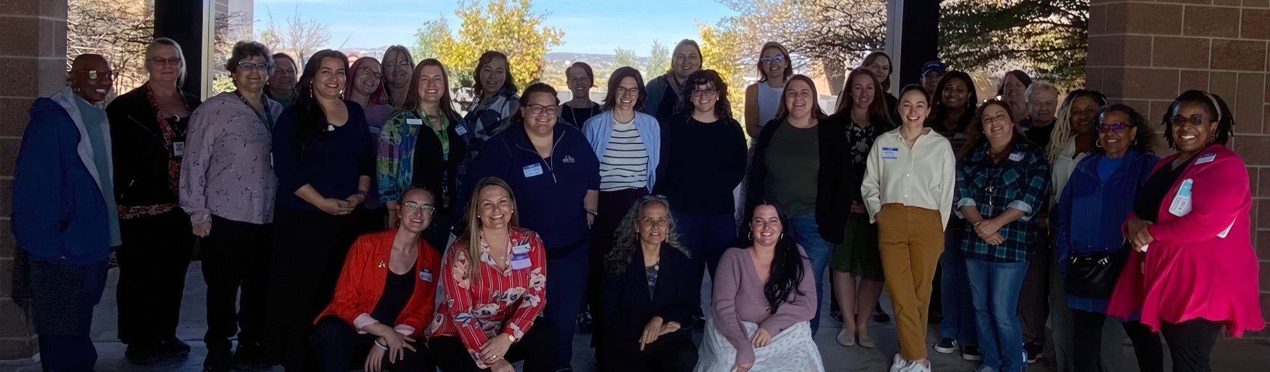
HR Updates
Chair Academy
Women’s Employee Resource Group

Slide 40

Kudos

Slide 41

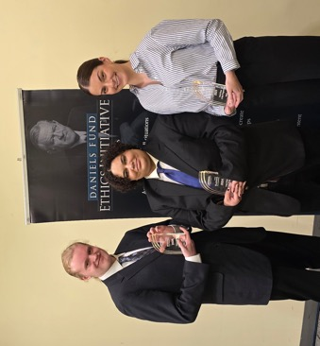
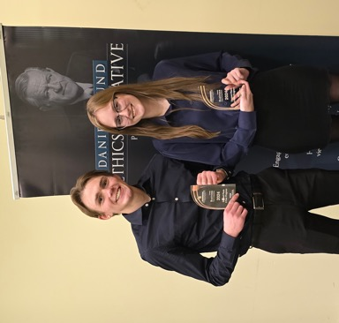
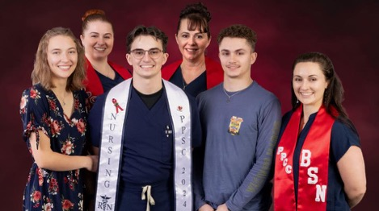

Kudos - Student
Blake MacDonald & McKenna Lovejoy Space Launch
Daniels Fund Ethics Case Competition 2nd and 3rd place winners
  PPSC faculty coaches/mentors: Carol Kurkowski and Monica Novack
  2nd place – Rylee Dextras and Dawson Rowbotham
  3rd place – Lauren Singleton, Jesper Sandeen, and Aidan Smith
Phi Beta Lambda: Our students compete both nationally and locally
  PPSC faculty coaches/mentors: Clint Schafer and Carol Kurkowski
  Foundations of Computer Science – 3rd Place, Elliott Bossetti
  Foundations of Technology – 6th Place, Elliott Bossetti
  Foundations of Entrepreneurship – 10th Place, Michelle Harris
Gage Vanaman and Family
  Gage Vanaman, 2024 ADN graduate and SNC President, was pinned at
  the December ceremony by his mom, Jenny, joined by sisters Haley and Jade—all PPSC Nursing graduates now working in Colorado.
Angelina Nguyen, a talented baker and cake decorator, was recently featured in Shoutout Colorado.
Blake MacDonald & McKenna Lovejoy
Daniels Fund Competition Second & Third Place Winners
Gage Vanaman & Family
Angelina Nguyen

Slide 42
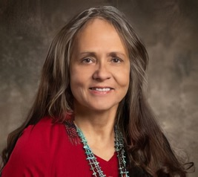
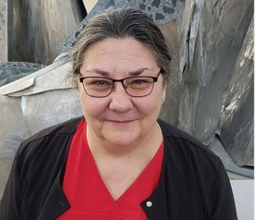
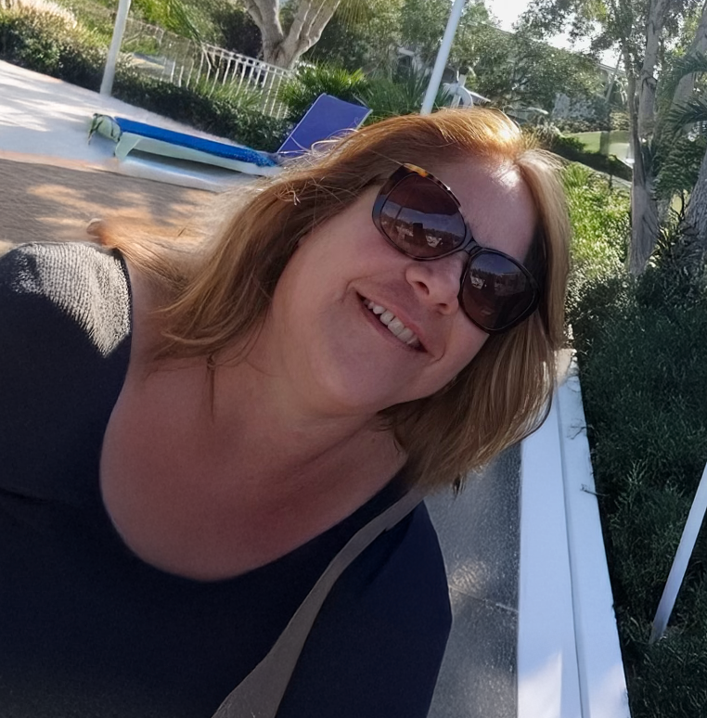
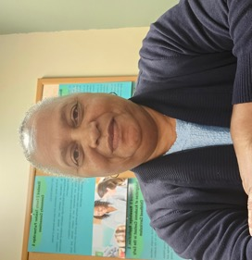
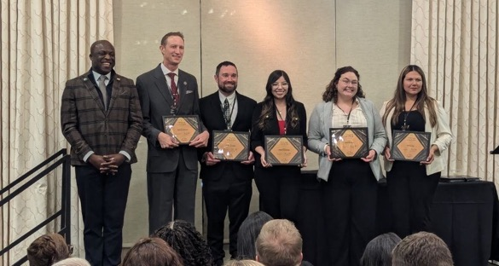
Kudos - Employee/Faculty
Employees of the year:
  Maria de la Cruz, APT of the Year
  Laura Genshorck, Classified of the Year
  Anita Marve, Instructor of the Year
  Amy Reed, Faculty of the Year
Mayor’s Young Leader Award Finalists
  Kandy Ruiz
  Hitcel Hernandez
The ESA Department presented at the National FEMA Conference.
Joel Ramirez from our Cyber Security department presented at the Hispanic Cybersecurity Consortium.
Culinary Arts and Hospitality presented at a Statewide ProStart Virtual College Fair on 10/24/24.
Maria de la Cruz
Amy Reed
Laura Genshorck
Anita Marve
Mayor’s Young Leader Award Finalists

Slide 43

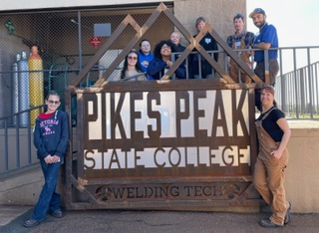
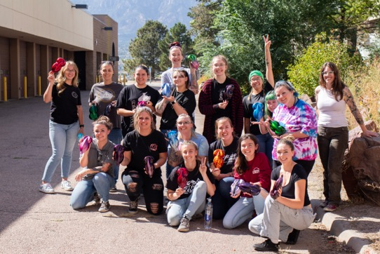
Kudos - Institutional
Military Gold Best for Vets
PPSC Hosted the Fall 2024 Mountain West Cybersecurity Consortium Conference. https://www.mtnwestcc.org/event-details/fall-2024-conference
Camps and workshops for women and girls to engage in the skilled trades
  Example: about 5% of the welding workforce identify as female and we
  held a very successful camp to engage young women.
Semiconductor Manufacturing partnership and PBS documentary
Partnership with UCCS for workshops for youth
  Pre-Collegiate Support and Success Center (Basic auto maintenance and broadcasting with BEM)
5-year internship (blanket) agreement with the City of Colorado Springs that includes programs across the college
Hosted the Colorado Registry of Interpreters for the Deaf Student State Conference with nationally recognized presenters
Girls Welding Camp
Women’s Automotive Workshop

Slide 44
Questions?

